Slide 1
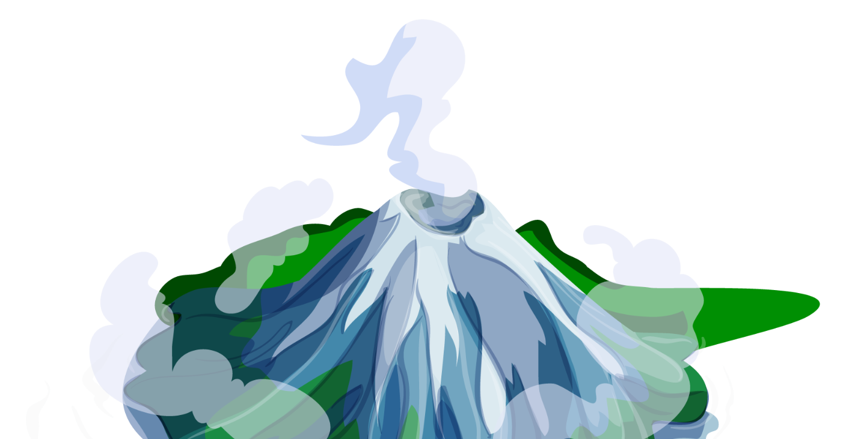
Rapid Mapping
Volcanic Eruption in La Palma
Pablo García García

Slide 2
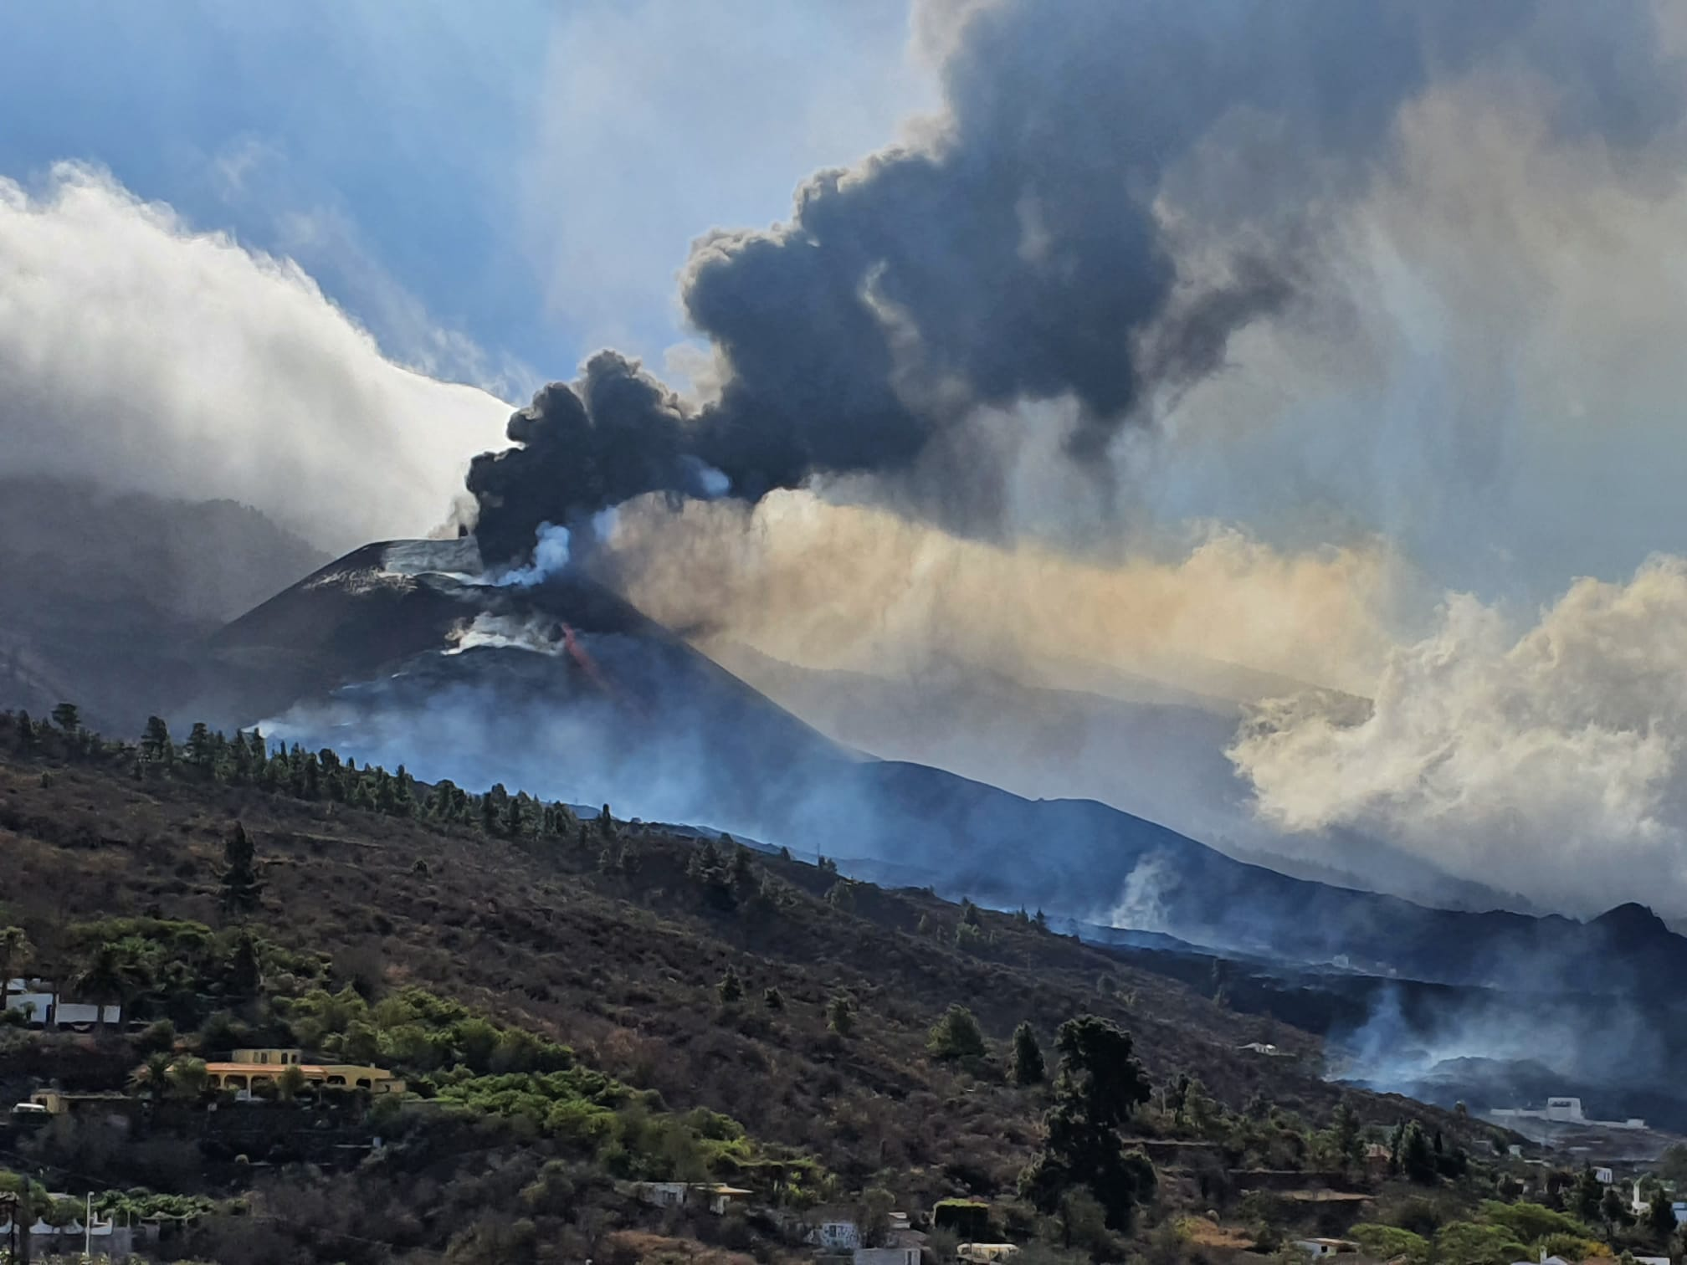
September, 2021
Notes:
This picture was taken by my parents.
In September 2021 there was a volcanic eruption on the island of La Palma, Canary Islands that lasted for approximately 3 months.

Slide 3
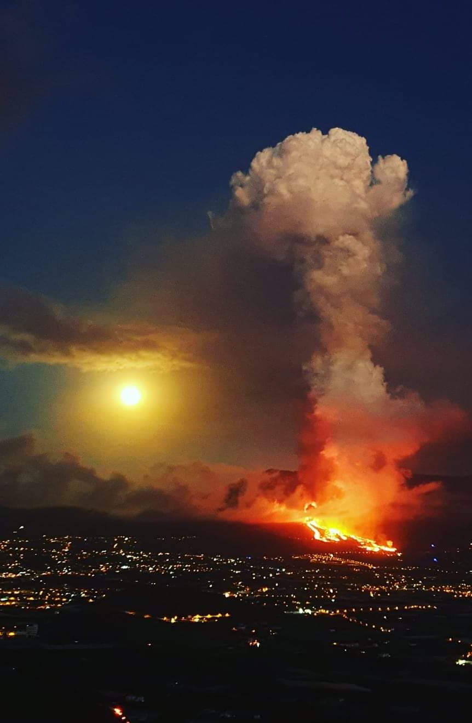
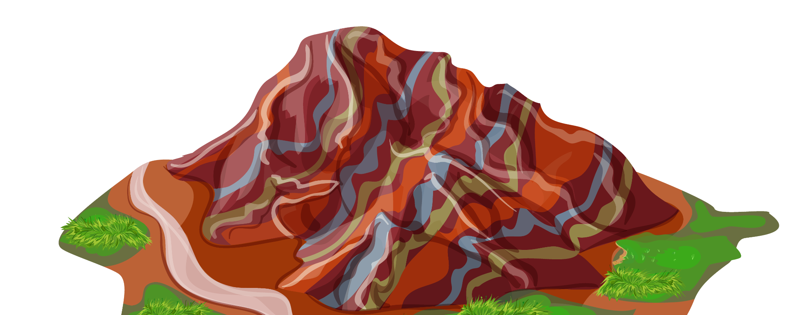
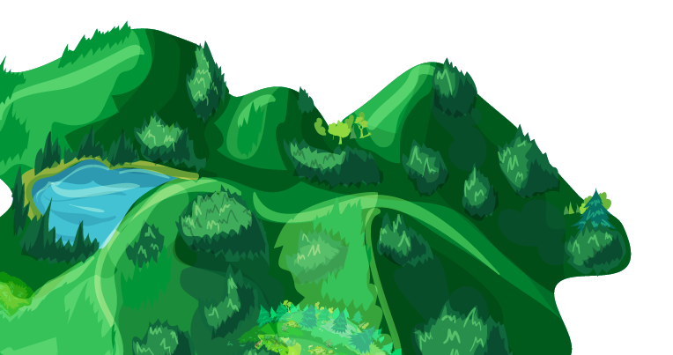


> 7000
> 3000
12 km²
843 Million €
Evacuated people
Destroyed buildings
Affected area
Total material damage
Notes:
Luckily, there were no casualties but it had a big impact on the island.
More than 7000 people evacuated and there was a lot of material damage (3000 destroyed buildings, coastal highway, etc)

Slide 4






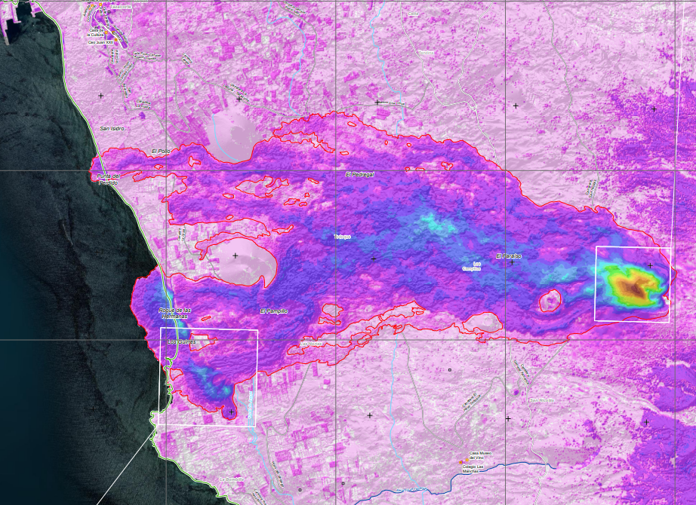
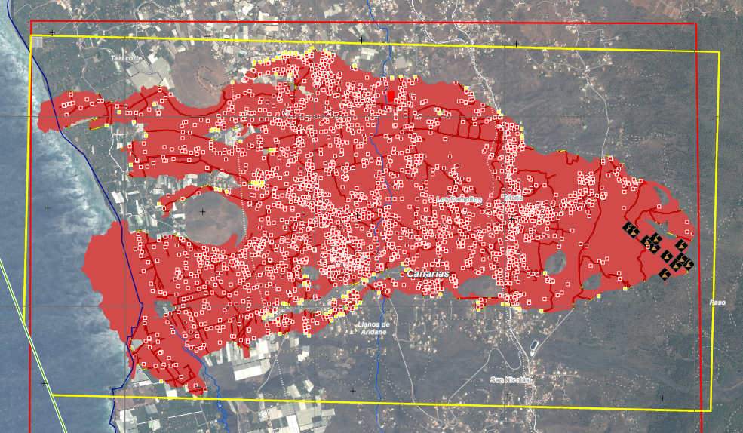
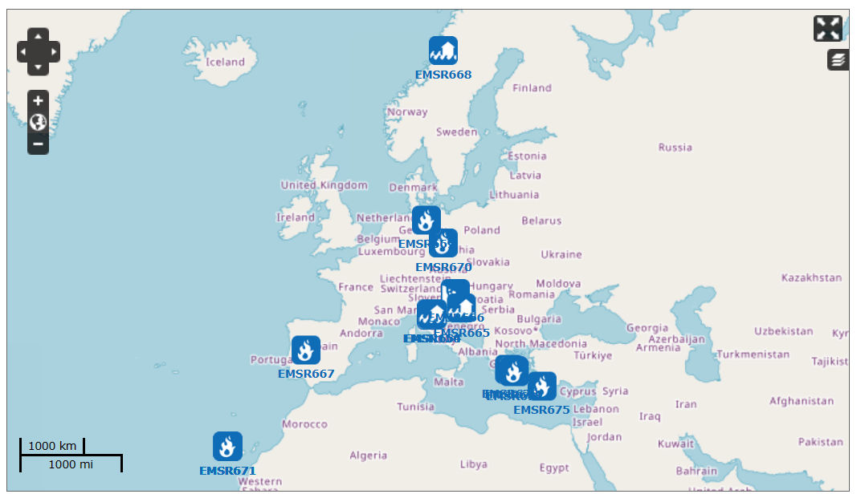

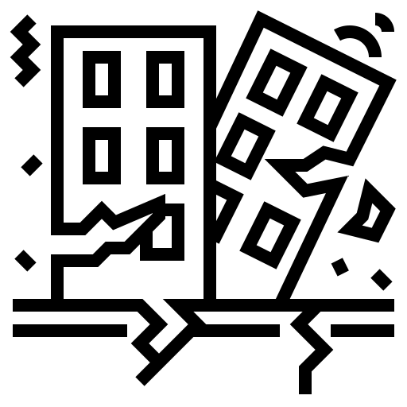

Rapid Mapping
Landslide
Flood
Storm
Fire
Eruption
Earthquake
Technical Accident
Notes:
During the eruption I came across this service from the European Union called Rapid Mapping, which is part of the Copernicus program:
Provides maps within hours or days of emergency situations.
Free of charge.
Accessible through a web portal.
The web interface looks like this:
Clicking on the emergency you can access very cool maps.
These are just examples of the maps created for the volcanic eruption in La Palma (extent of the lava flow, affected buildings and elevation change on the island).

Slide 5

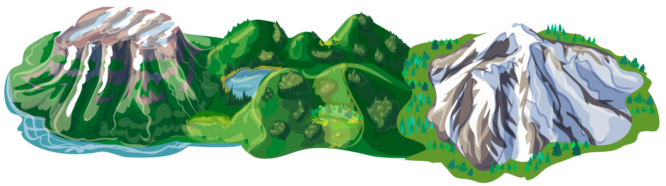
Objectives
Write Python code to determine…
Area covered by the lava flow
Number of buildings affected by the eruption
Island’s morphology change
Notes:
My objective for this project were:
Write some Python code to reproduce the maps created by Rapid Mapping service.
Specifically:
Determine the area affected by the lava flow
Determine the number of buildings affected by the eruption
Determine the island’s morphology change

Slide 6




Data
Satellite images
Digital terrain models
Point Cloud Data
Notes:
Data for this project was taken from:
EU’s Copernicus program: satellite images
Spanish Mapping Agency: did a lot of mapping on the island before and after the eruption.

Slide 7
Workflow
Extract Lava Flow
Classify
Buildings
Elevation
Change
Unsupervised Machine Learning
(K-Means, DBSCAN)
Supervised Machine Learning
(Random Forest Classifier)
Raster Difference (Rasterio library)
Notes:
This is an overview of the steps I followed in my project:
1. Get the extent of the lava flow. For this I used a satellite image from the Copernicus program For this I used Unsupervised Machine Learning.
2. I needed a way to detect buildings. For this I used Supervised Machine Learning and a dataset from the Spanish Mapping Agency that had already classified buildings to train a model.
Having the area affected by the lava and the buildings I could compute the affected buildings.
3. Elevation Change: i used two Digital Terrain Models (before and after the eruption) and computed the difference using Rasterio (Python library)

Slide 8
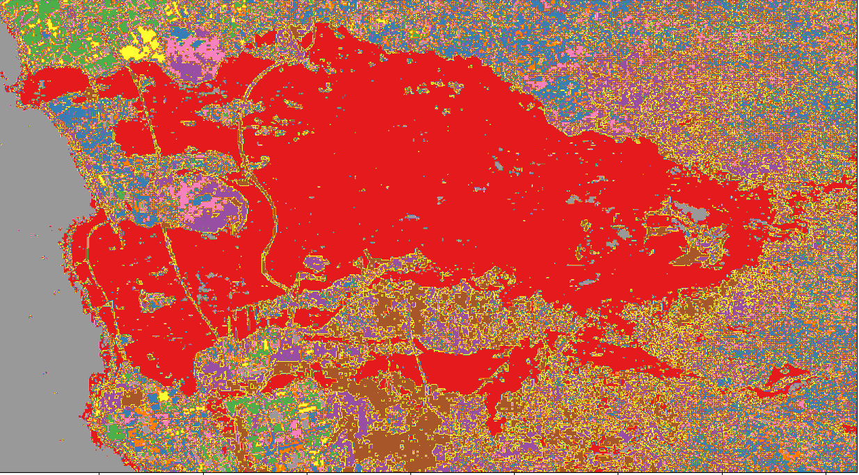
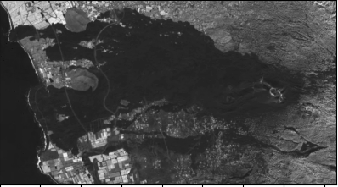
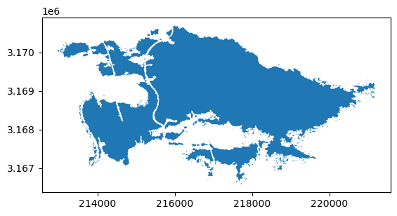
Lava Flow
Notes:
This is a bit more information about each of the steps:
Satellite image after the eruption. (coastal highway had already been opened)
Clusters from the Unsupervised Machine Learning
Finally I extracted the polygon

Slide 9
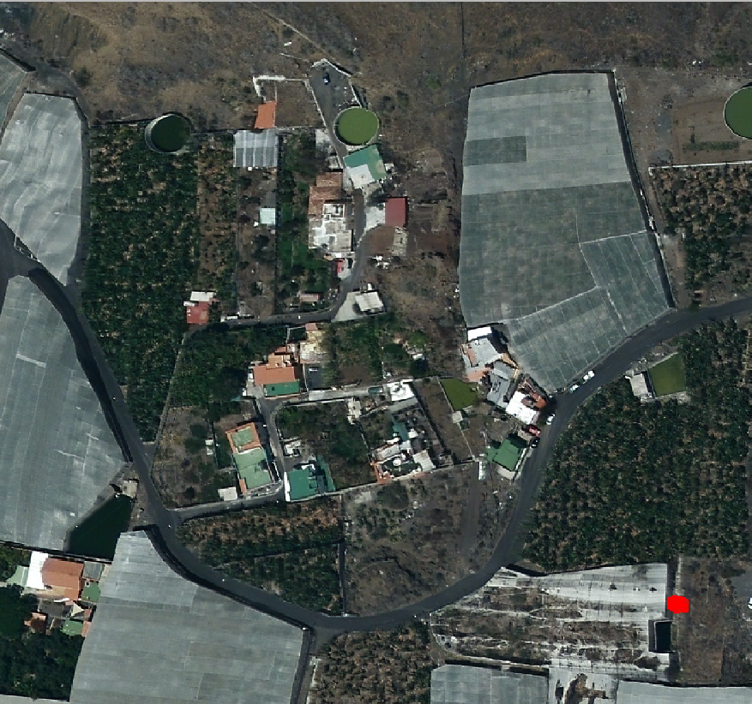
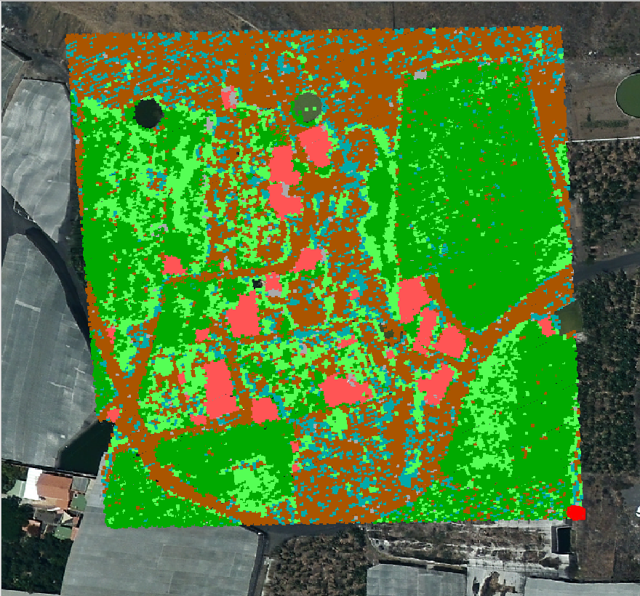
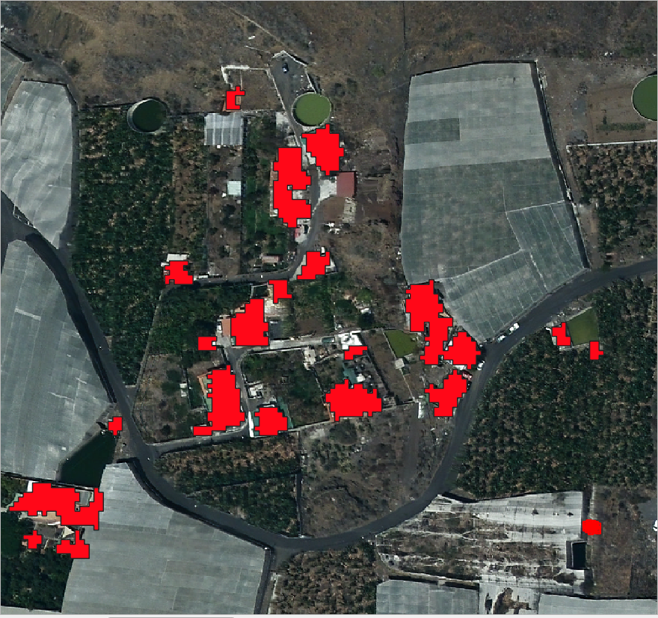
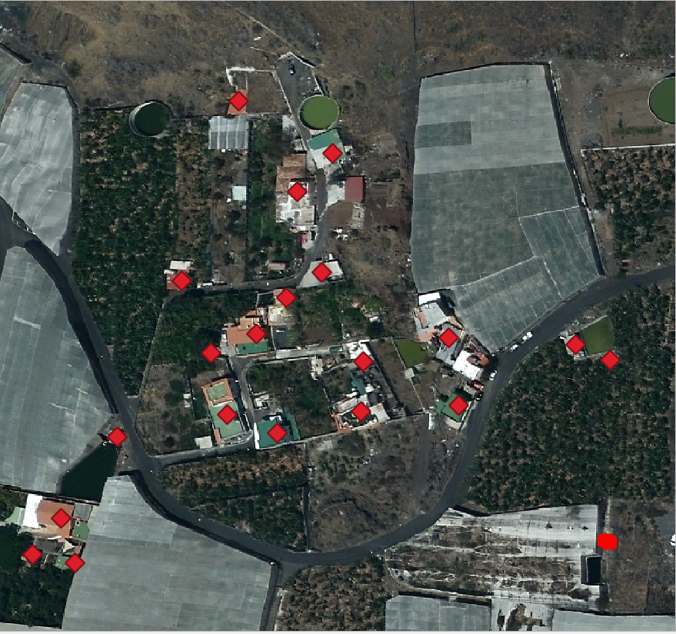
Buildings
Notes:
To detect the buildings:
I used a classified dataset from the Spanish Mapping Agency (red points are the classified buildings)
Used that dataset to train a ML model and
Finally I created a polygon around the buildings.
And extracted the centre point

Slide 10
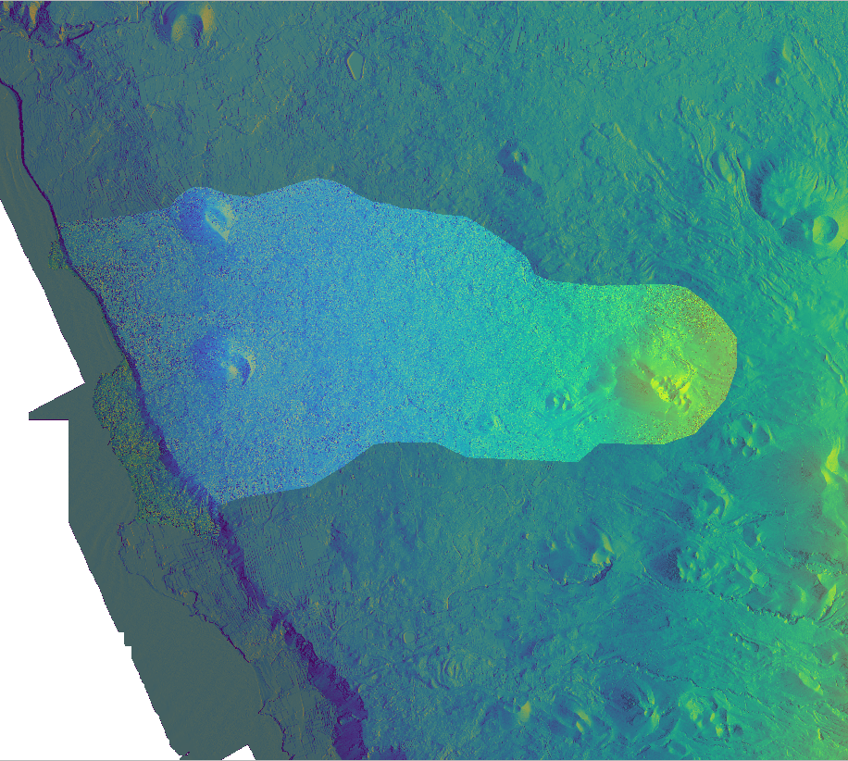
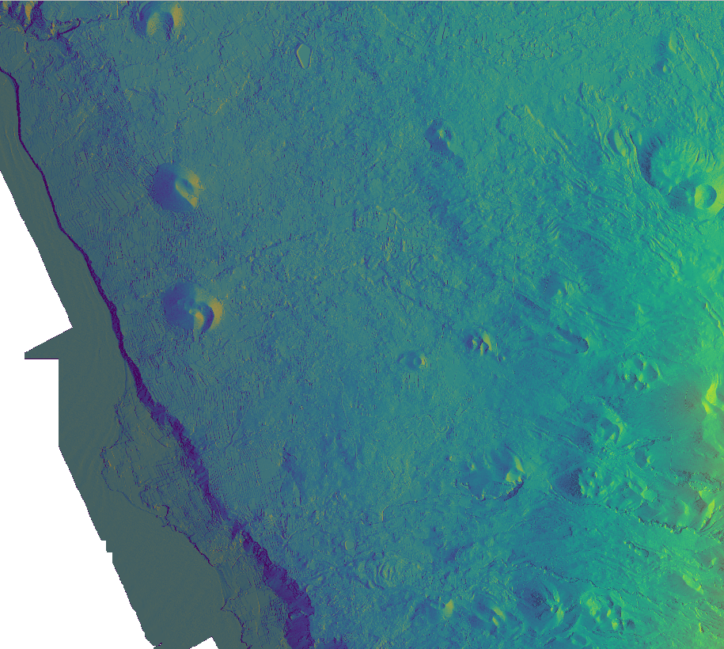
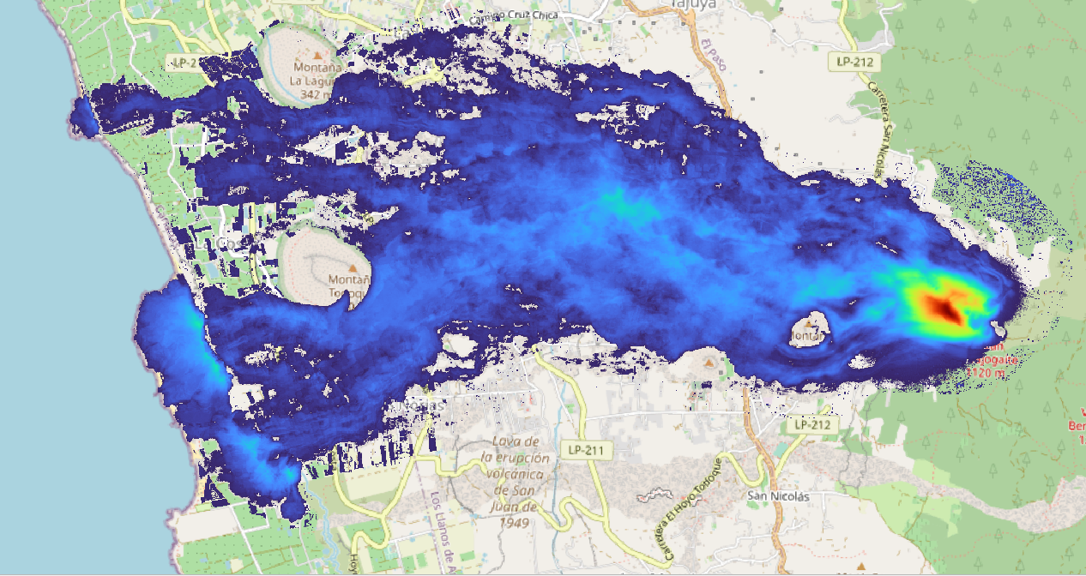
Elevation
Notes:
To quantify the elevation change, I digital terrain models before and after the eruption.
This is the difference in elevation:
Red: 190 m
Blue: 10-30m

Slide 11
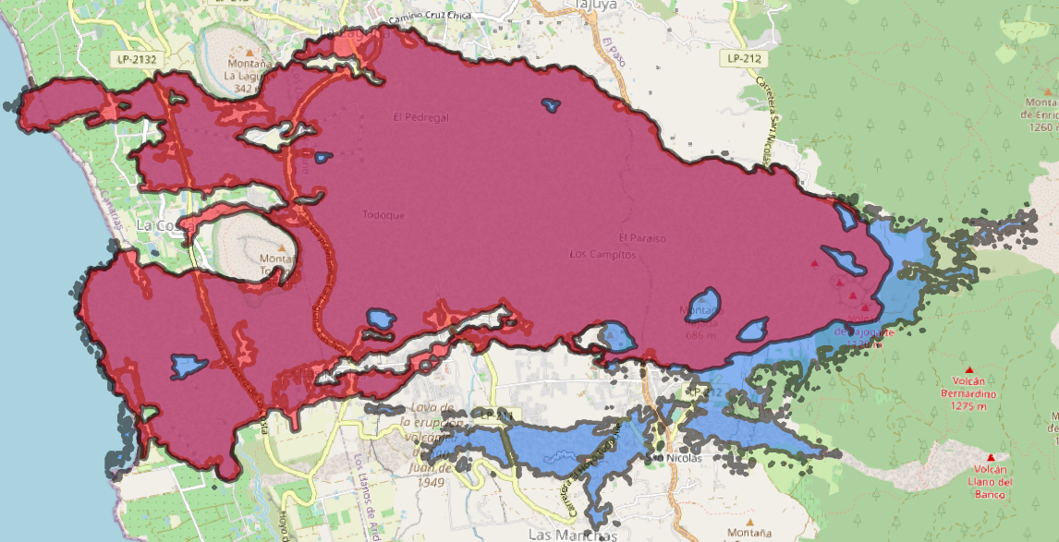
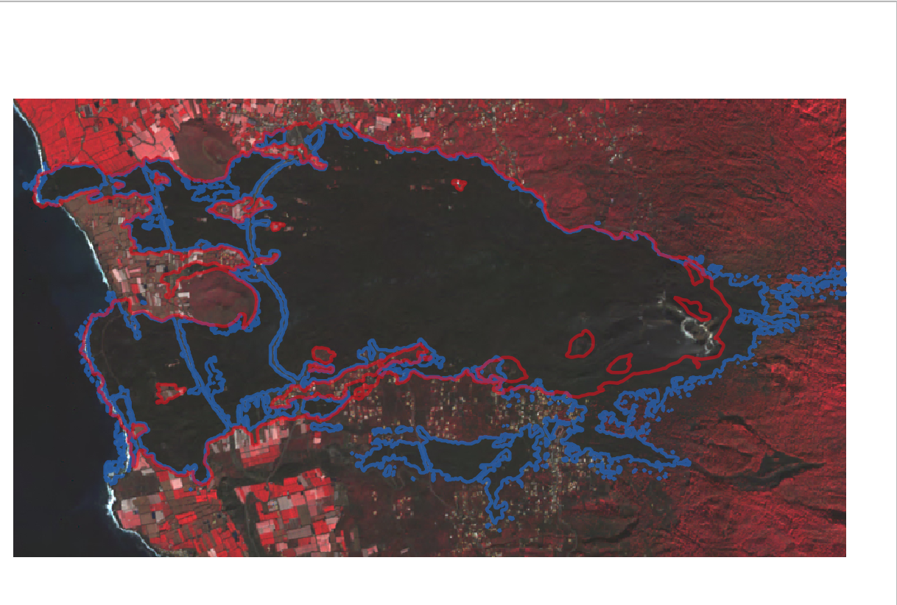
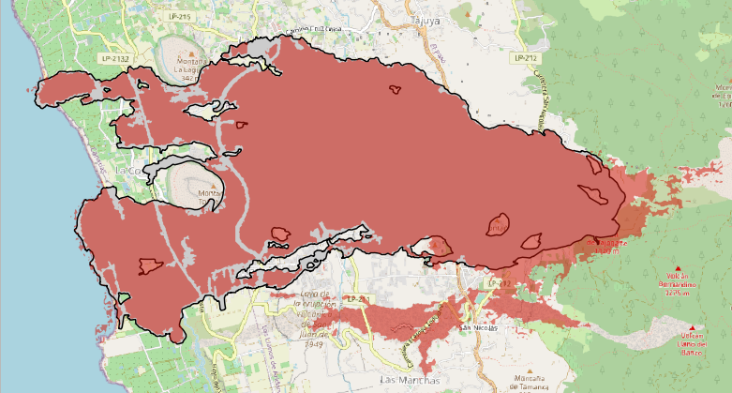
12.4 km² vs 12.9 km²
Results
Notes:
For the final part of the project, I compared my results (in BLUE) them with the results published by the Rapid Mapping service (RED).
This slide you can see the difference for the lava extents.
Good match, but in my model the area is approx. 0.5 km2 bigger.
Looking at the satellite image we can see that this is because the model included this black area that was not actually part of the eruption.

Slide 12
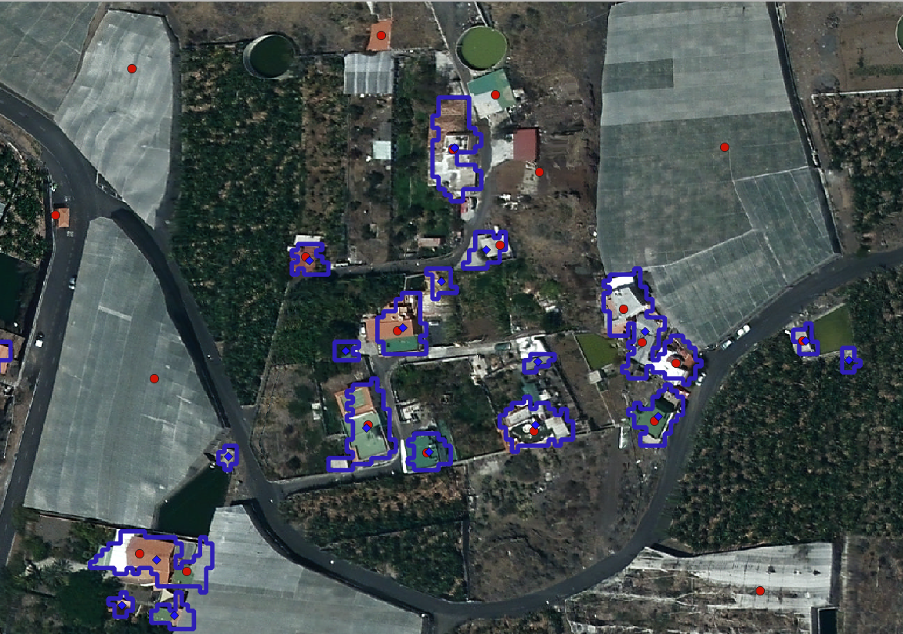
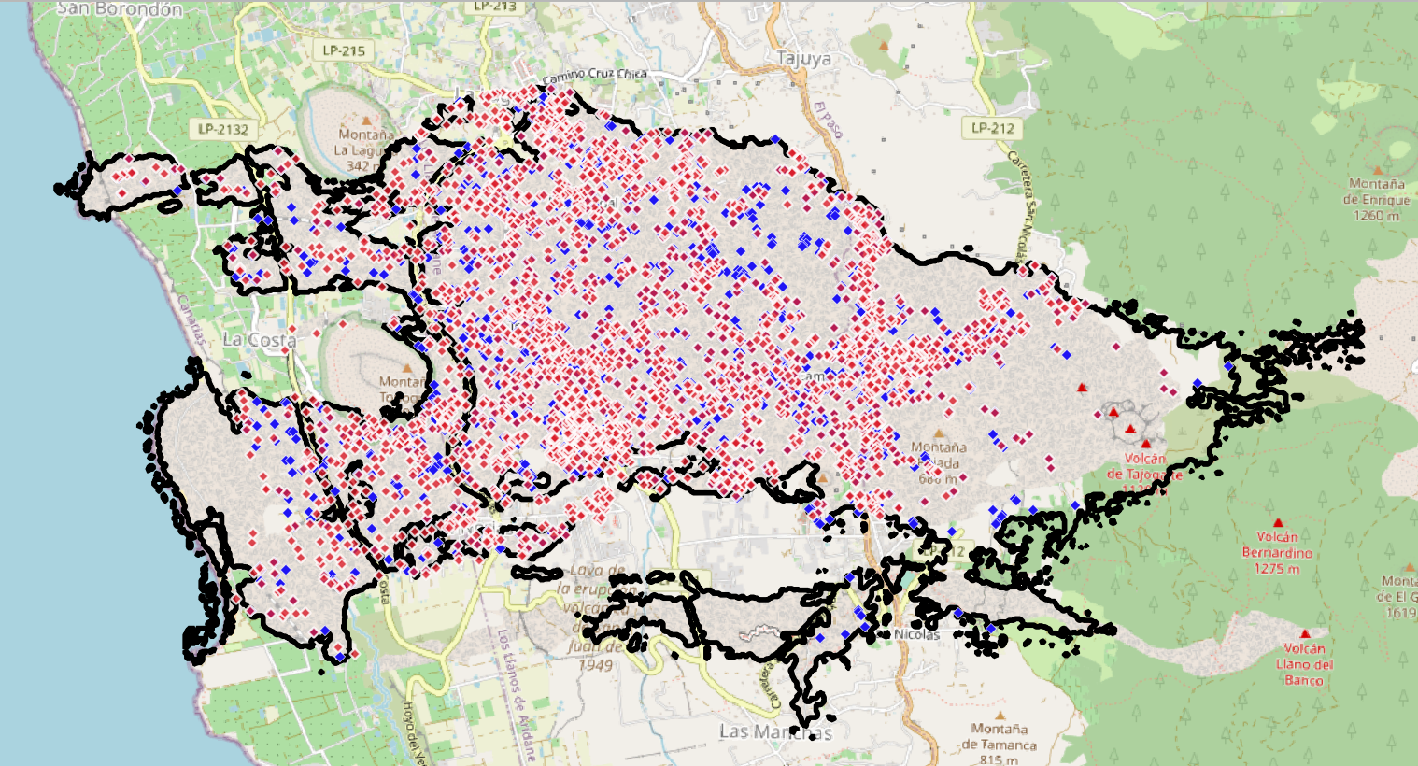
3126 vs 2567
Results
Notes:
This slide you can see the difference for the affected buildings (RED what was published, BLUE my results)
In this case, my model is underestimating the number of affected buildings by approx 559 buildings.
Looking at a specific area we can see that there are two reasons:
Rapid Mapping was counting greenhouses as affected buildings.
Buildings that are close together are counted as a single buildings in my algorithm.

Slide 13
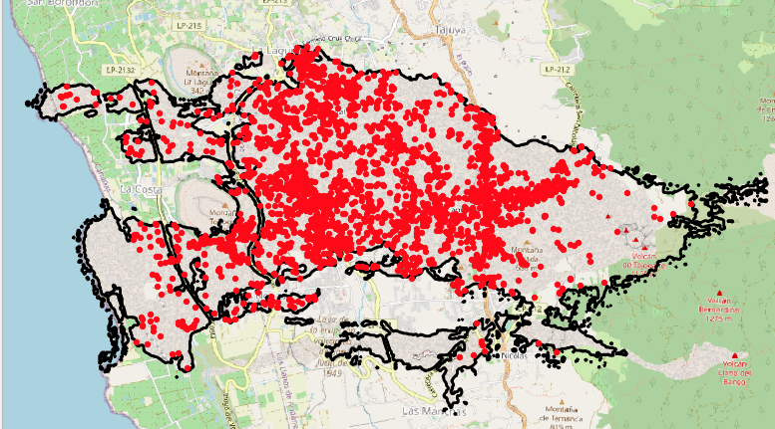
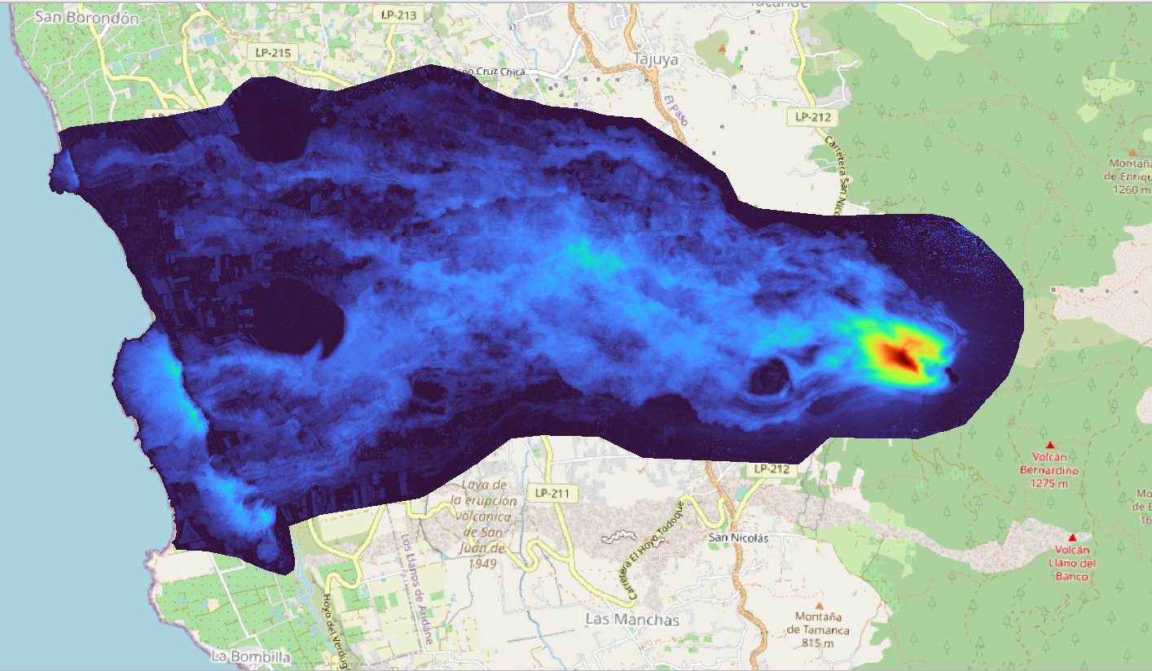
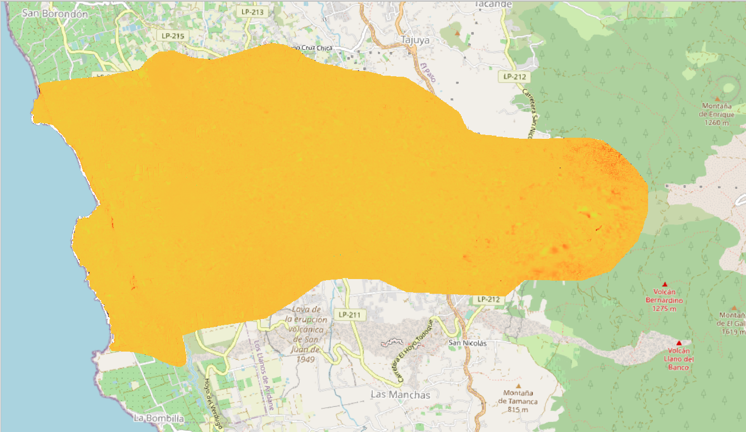
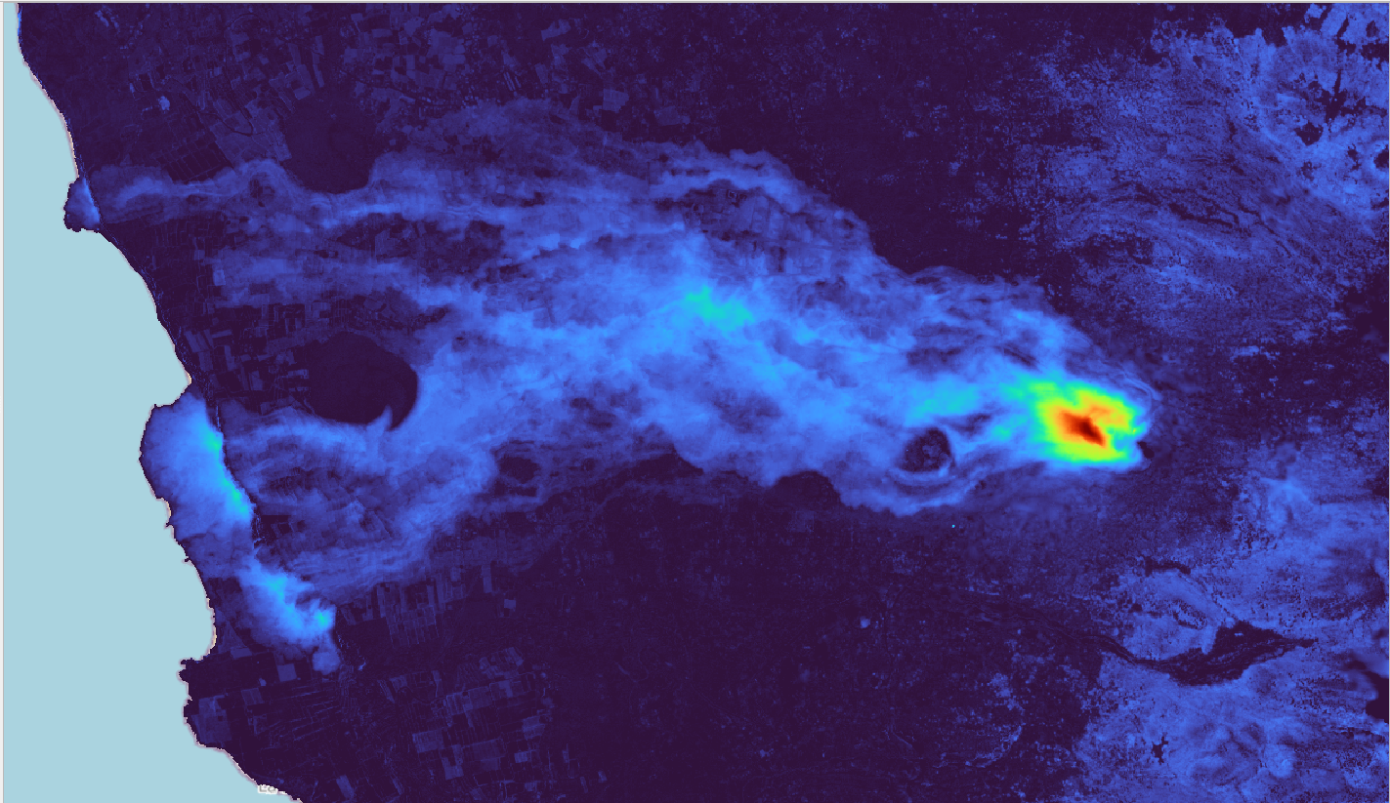
Results
Notes:
This slide you can see the elevation change published by the Rapid Mapping service and my results.
This is the difference between the two, which indicates that there was a good match in the results.

Slide 14

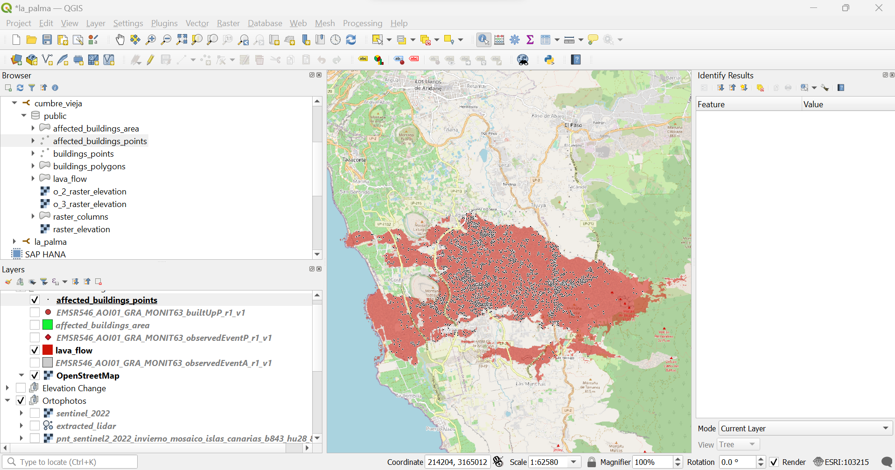

Database
Notes:
Database demo: For the final part I stored the different files in a database (PostgreSQL + PostGIS).
The

Slide 15
Thanks!
Do you have any questions?

